Slide 1
Business meetings
Definition
Key components
Types of meetings
Purposes and meeting agenda samples
Announcement emails
Participating in meetings
Chairing the meetings

Slide 2
What is a business meeting?
A business meeting is a scheduled gathering of two or people for a structured discussion guided by a designated chairperson for the purpose of making structured decisions or discussing company objectives and operations. Here they share their knowledge, experience, views and suggestions.
Business meetings are generally conducted in person at an office, however with the rise of video conferencing technologies, participants can join a business meeting from anywhere online.

Slide 3
Business Meeting-key components
Agenda: This is the plan for the order of things to talk about at that meeting.
Item: Each part of the agenda is called an item.
Action Item: If someone needs to do something after the meeting it's often called an action item.
Chair: The person who is in charge of a meeting is called the Leader, the Lead or sometimes the Chair. The Leader runs or leads the meeting.
Minutes: The written summary of what was discussed and what was decided in the meeting is called the minutes of the meeting.

Slide 4
STEPS IN Organizing meetings
Determine meeting type and purpose
Prepare agenda
Identify attendees
Decide for a suitable time
Select a convenient venue
Sending meeting announcement

Slide 5
TYPES OF MEETINGS

Slide 6
Types of group meetings:
Two general types:
1: Informal:
Unplanned, and spontaneous. Free flowing meetings or get to gathers for social purpose which may latter develop into formal meetings.
2. Formal:
These are structured, task oriented, often search for solution to problems, look for a course of action, to make recommendations to a higher authority, and change policy etc.

Slide 7
Types of meetings (Internal office meetings)
Information meeting-to explain something
Team meeting-teams share info, give updates, make decisions, announcements
Kick off meeting-different departments meet for a project
Progress report meetings
Debrief meeting-to discuss what was or wasn’t successful about a project

Slide 8
Types of meetings (Internal office meetings)
Decision-making meeting-to reach agreement on one or more issues
Brainstorming meeting-to think or share new ideas about a topic or to solve a problem
Delegate work meeting-to assign tasks to people, giving details
Persuasive meeting-to achieve group consensus and gain support for a course of action

Slide 9
Identify the type of the meeting
You work for a small coffee shop company with a few coffee shops in town. You would like to add some food. You want to get some ideas from your team.(Brainstorming meeting)
You've just reorganized the management team in your organization and you want to explain it to your department.(Information meeting)
You want to select a new software program for your design team.(PERSUASIVE MEETING)
Your international sales team needs to have its monthly meeting.(TEAM MEETING)

Slide 10
PURPOSE OF MEETINGS

Slide 11
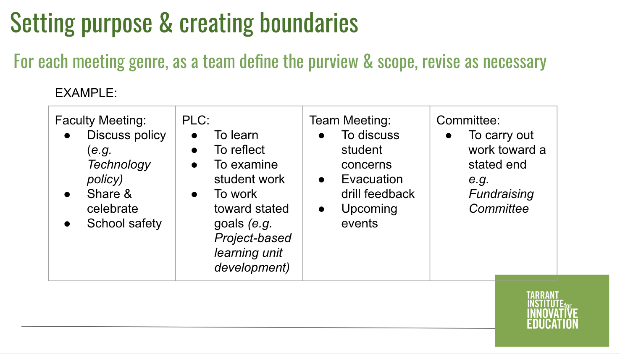

Slide 12
Read some email message extracts and determine the writer’s purpose
I need to schedule next month's team meeting. I'd like to set up a meeting for next week.
I'm trying to arrange a meeting for sometime next week. I want to find a time for us to meet.
I'd like to propose Monday, May 2nd at 10 a.m. How about Thursday afternoon at 2:00? Would Wednesday at 9:00 work for everyone?
Here are some options, let me know what you think. Which of these days and times work for you? Let me know which of these dates you prefer.
Please let me know when you are available. When is a good time for you? Can you give me sometimes when you are free?

Slide 13
Read these responses and identify their purpose
Hi Karen, I'd like to add some time to talk about the new store. We probably need about 15 minutes.
Hi, Karen. I would like to add an item to the agenda. I think we need to discuss next month's advertising campaign. I'm not sure how long we need, but I think it's important.
Dear Lauren, I am writing to let you know that I am unable to attend next week's meeting. I have a previously scheduled appointment on that day.
Dear Lauren, I'm writing to inform you that unfortunately, I am unable to attend next week's meeting. I'm going to be out of the office on Monday. I'm on vacation all next week. My apologies. I'm sorry for any inconvenience.

Slide 14
From a participant’s response, identify the issues with the meeting.
I wanted to contribute because I thought I had a few good ideas, but I didn't feel comfortable giving my opinion, so I just kept quiet. The meeting room was small so we were all sitting really close together. There was also construction work going on outside so it was hard to hear.

Slide 15
Essentials of a successful meeting
Agenda is prepared.
Participants come prepared.
Chair runs the meeting effectively.
No deviation from agenda
Honorable behavior
Suitable venue
Suitable time
Even participation
Logistics:
Parking, Venue, seating arrangement, number of seats, refreshments, other physical requirements.

Slide 16
MEETING AGENDA. AGENDA SAMPLES

Slide 17
Preparing agenda
AGENDA:
The outline/list/schedule/calendar of items to be discussed and tasks to be accomplished during a meeting.
The agenda will be provided by a superior, but in the form of vague instructions.
The concerned attendees are also consulted to suggest agenda items.
The concerned attendees are also contacted to decide for a suitable time.

Slide 18
Communicating With attendees
Inquiring about availability
Asking for agenda items
Informing the concerned participant to come prepared if s/he requires to report about a matter or manage discussion about a matter

Slide 19
IMPORTANT elements OF AGENDA
Identify lead person for each topic
Individual and Committee Reports
Unfinished and New Business
Announcements
Adjournment
WHAT, WHEN, WHERE,WHY
Date, Time, and Place
Purpose (why)
Topic at hand (what)
Provide time markers for each separate item.
Anticipate more controversial topics

Slide 20
Work on the following message by a superior to develop the agenda
Hey Ali. Karim here. I just wanted to let you know that I'm going to be out of the office for about ten days and wanted to ask if you could organize a team meeting for the first week of next month. As well as our regular updates I'd like us to discuss the remodeling of the North Karachi Imtiaz store. We need to give input on which design we prefer. I'd also like us to decide if we need more money in our budget, so it would be good if you could invite Ahmed to join us too. Thanks and let me know if you have any questions. You can call me on my cell. See you in two weeks.

Slide 21
Preparing agenda
Agenda items must be clear.
The items must start with a nominalization (noun made from a verb) or a formal action verb, e.g. “Vote on Approval of Next Year’s Budget”.
In less formal team meetings, agenda item can be phrased as questions or statements, such as, “Which design do we prefer?” or “Decide whether to request an increase in our marketing budget”.
The agenda item may also mention the name of the person responsible to brief about that particular item.
The last item is usually “New Business” or “Any other matter” to allow participants to discuss any other issue related to the purpose of the meeting.

Slide 22
agenda Sample 1.
Executive Committee Agenda for the meeting on – Apr. 20, 2021, to be held at EE Auditorium at 9:AM. All the respected management staff are requested to join. Before coming, you should read the status report on audit and tax returns for the company.
7:30 PM Call to Order(“I call this meeting to order.”) & Roll call (leader) Mr. A
7:35 Action on Minutes of April. 05, 2019 Ex.Com Meeting Miss. A
7:40 Status of 2018 Audit and Tax Returns  Mr. C
7:55 Latest on Third Play and Inter-District Registration Mr. B
8:10 Establishing E-Donation Capability (action desired) Mr. A
8:20 Soliciting Donations to MAR at Events (review process only) Mr. A
8:45 Major Topics for March 19 Board Meeting Mr. A /All
8:55 Adjourn to Executive Session for Personnel Discussion Mr. A
9:00 Targeted Adjournment
Note:  Indicates separate document for this item

Slide 23
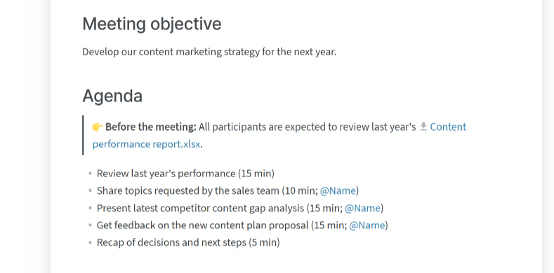
Sample agenda

Slide 24
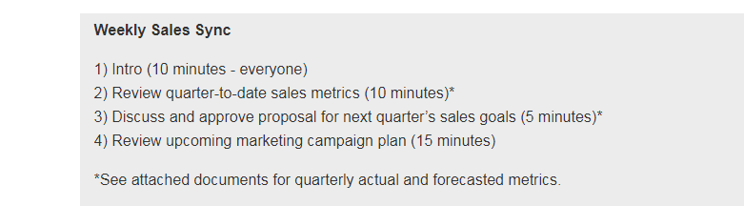
Sample agenda

Slide 25
meeting announcement email

Slide 26
Writing the ANNOUNCEENT EMAIL
Write a clear subject line.
Greet the participants.
Provide the details of the meeting (meeting name (if any), purpose, date, time, venue).
Give some background.
Announce meeting agenda/items to be discussed.
Instruct participants about any research or preparation will be needed on their part. Also, mention names if necessary.
End with a cordial statement.
(WHAT, WHEN, WHERE WHAY)

Slide 27
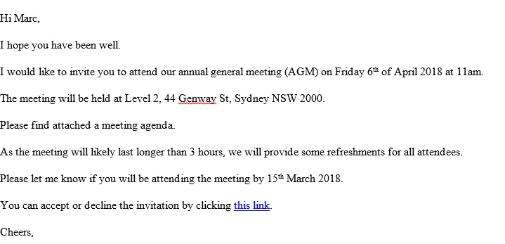
Sample email

Slide 28
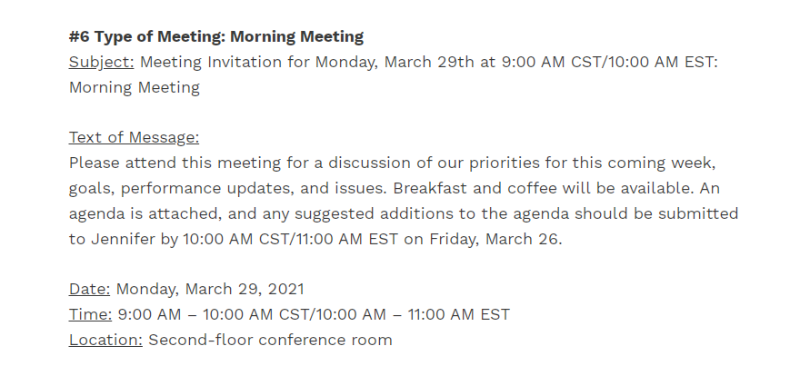
Sample email

Slide 29
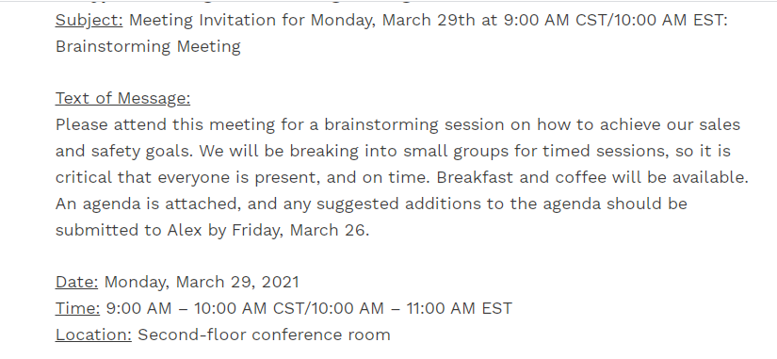
Sample email

Slide 30
Responding to meeting announcements/agenda item calls
You can suggest agenda items.
You can request for change of timings.
You can apologize for not being able to attend. But, in this case mention your genuine reason.

Slide 31
Planning.
Meetings can go wrong in many ways. For example, they may deal with trivial issues, or fail to deal with a major issue for many reasons.
They can be irrelevant, unfocussed, badly chaired, boring, long, digressed, and fail to reach conclusions.
Careful preparation can solve these problems. For that, consider the following.
what is the purpose?
Who should attend the meeting?
When and where will the meeting be held?
What information should participants receive in advance?
What will be your role in the meeting?
Who will be affected by the outcome and so needs to be consulted?
Who can supply any relevant information?
Who can play a vital role in taking any follow-up action?
Decide when and where of the meeting?

Slide 32
PARTICIPATING IN MEETING DISCUSSIONS

Slide 33
Prompt:
What kind of strategies/Methods you generally use to solve problems in a meeting?
Approaches;
Intuition (rapid inside into the problem)
Rationalization (Justification of solutions over time)
Scientific or reflective thinking (logical progression towards a solution). Most of the times, this approach is used in business meetings.

Slide 34
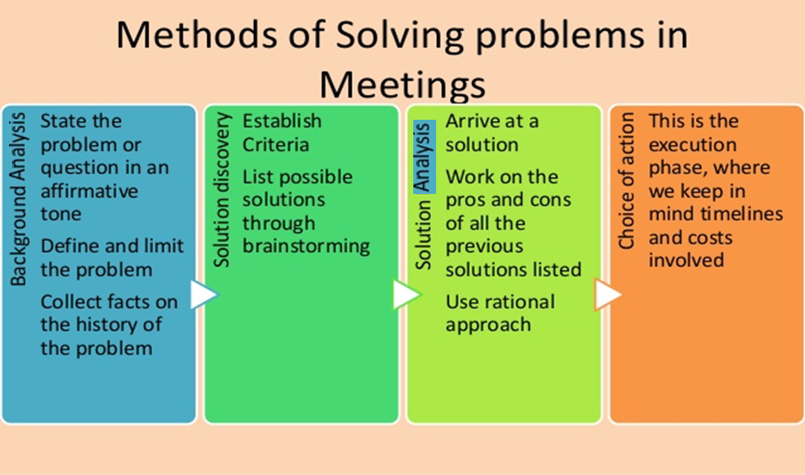

Slide 35
Participating in meetings
Be an interested and useful participant
Demonstrate your abilities and competence
Read the agenda and do the homework
Arrive on time
Express opinions with tact and firmness
Support the chair in improving the quality of the discussion
Listen actively

Slide 36
Participating in meetings
Speak clearly
Avoid personal attacks
Use positive body language
Discuss, don’t argue
Take notes

Slide 37
CHAIRING A MEETING

Slide 38
Chairperson’s Tasks
Pre-Meeting | During the Meeting | Post-Meeting
Plan the meeting Notify members Distribute materials Remind members Prepare for discussion | Begin on time Delegate minutes Follow the agenda Facilitate the discussion Provide closure | Evaluate the meeting Distribute the minutes Monitor assigned tasks Follow ups

Slide 39
CHAIRING A MEETING
For an effective leader, knowing three kinds of leadership is vital.
AUTHORITARIAN | Shows contempt those disagrees and praises who agree, dominant, loud, orders and commands, defends one`s self.
LEADERLESS | Delegates directions and decision making steps to others. Shares leadership, allows high ability people to run the meeting. Its rarely beneficial. Team lacks positive motivation.
DEMOCRATIC/ PARTICIPATIVE | Group has final authority. Leader helps group make best decision, invites minority opinions, evaluates unsupported generalizations, clarifies vague statements, allows others to conclude, & facilitates productive discussion .

Slide 40
Chairing a meeting
Introduction
Begin with roll call
State the objective of the meeting
Bring up agenda item 1 and start discussion
Introduce participants with each other (if new)
Greet and socialize
Delegate minutes

Slide 41
Chairing a meeting
Main meeting
Encourage participation
Ask open ended questions
Ask participants by name to respond if they are inactive
Observe participants’ non-verbal feedback and identify confusions and address the issue
Summarize key points of after every agenda item for clarity and build consensus

Slide 42
Chairing a meeting
For difficult participants, keep calm and don’t lose your composure. Deal with them professionally.
Use the agenda items to keep everyone focused and avoid distractions.
Be fair and a good role-model by demonstrating work ethic.
Recognize contributors by valuing their insights.
Maintain high standards regarding discussions.
Maintain discipline by requesting participants to avoid cell phones or talking to each other.
End on time.
End with a summary of decisions and actions items.

Slide 43
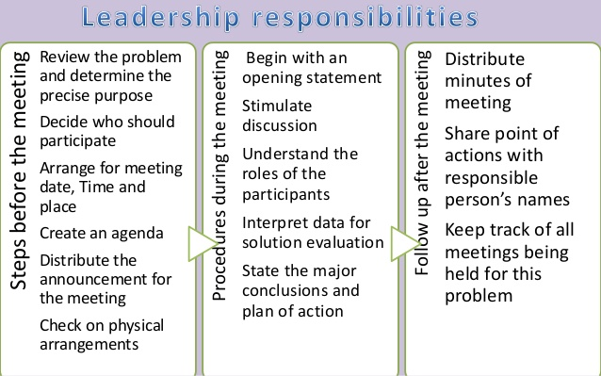

Slide 44
From a participant’s response, identify the issues with the meeting.
We didn't start for 20 minutes because people were just chatting and then the meeting went on for an extra hour. One of the participants wouldn't shut up. No-one else was able to speak. I didn't really know what we were supposed to be talking about, and at the end I didn't know what we had decided. I felt it was a complete waste of time. I came prepared because I had read the documents that we were supposed to discuss, but it was really clear that a lot of other people at the meeting hadn't read them. Some of them didn't even bring the documents at the meeting. I felt so frustrated.

